Slide 1


Weather Classification with Deep Convolutional Neural Networks
Mohamed Elhoseiny¹, Sheng Huang², Ahmed Elgammal¹
¹Rutgers University ²Chongqing University
1
Notes:
Add slide number\

Slide 2

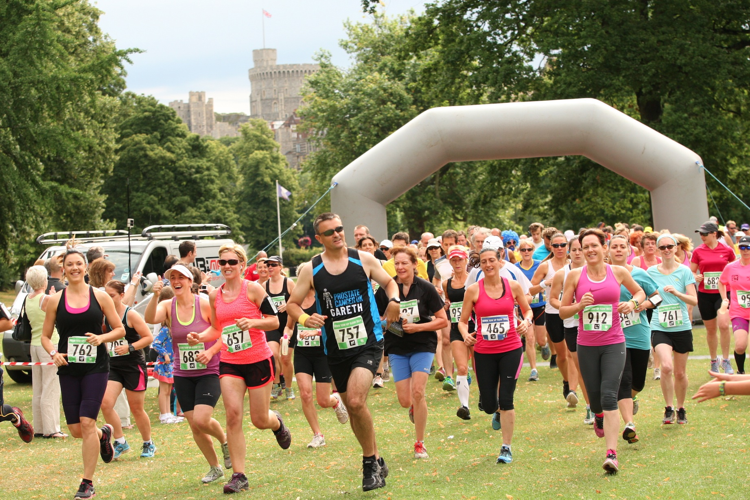
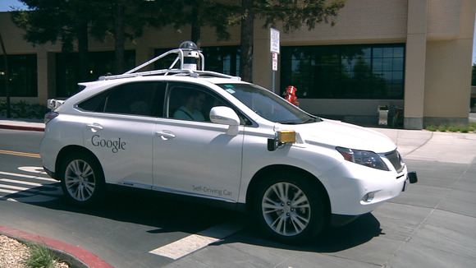
Weather Classification with Deep Convolutional Neural Networks
Weather condition strongly influences both daily life and several visual systems
Solar Energy Systems
Outdoor sporting Events
Vehicle Assistance Driving Systems
2

Slide 3
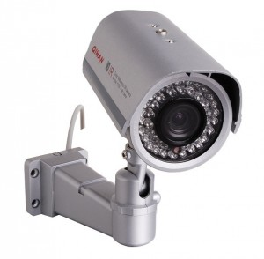

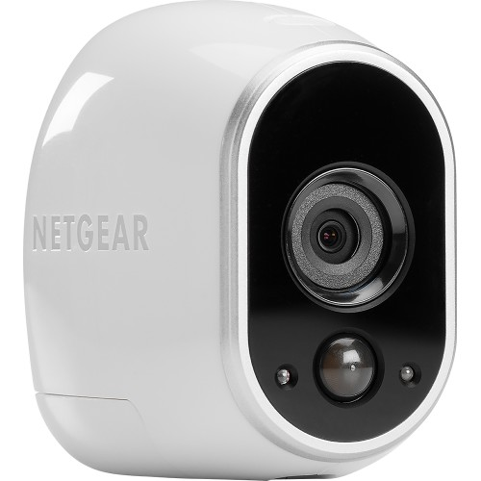
Weather Classification with Deep Convolutional Neural Networks
Economical surveillance cameras are ubiquitous
Developing weather classification system from only images help
Save Human Resources
Save Expensive instrumental resources (e.g. expensive sensor).
3

Slide 4
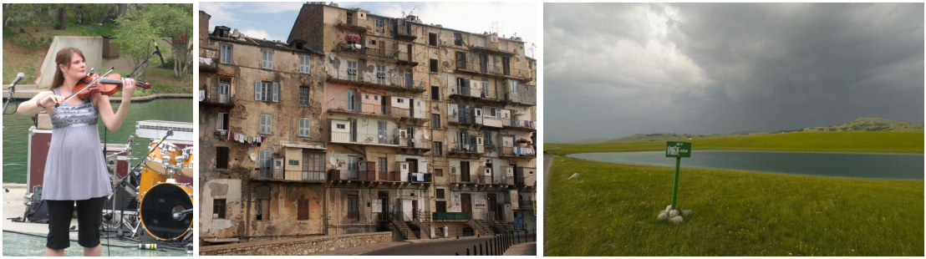
Weather Classification with Deep Convolutional Neural Networks
Weather Classification from only image is challenging
Cloudy
4

Slide 5
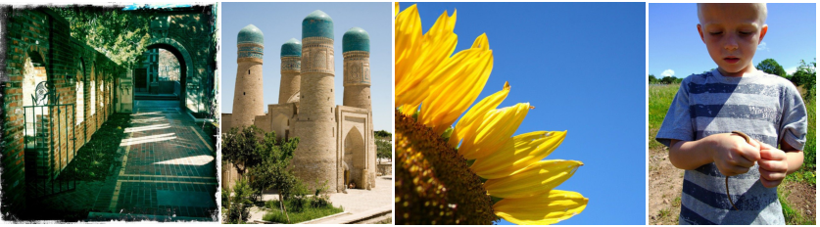
Weather Classification with Deep Convolutional Neural Networks
Weather Classification from only image is challenging
Sunny
5

Slide 6
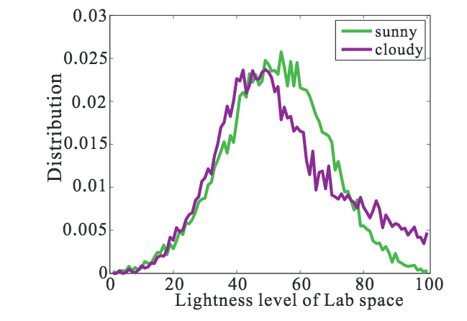
Weather Classification with Deep Convolutional Neural Networks
Could be Resolved by Lightness?
Figure from Lu, etal, CVPR, 2014
6

Slide 7
Weather Classification with Deep Convolutional Neural Networks
Prior Solution (Lu etal, CVPR, 2014).
621 feature vector formed by
Sky
Shadow
Reflection
Contrast
Haze
7

Slide 8
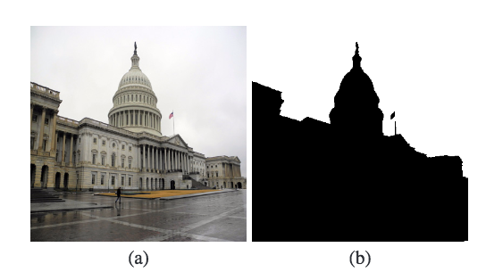
Weather Classification with Deep Convolutional Neural Networks
Prior Solution (Lu etal, CVPR, 2014).
621 feature vector formed by
Sky
Shadow
Reflection
Contrast
Haze
8

Slide 9
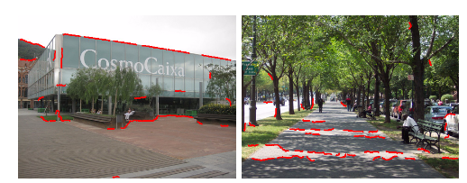
Weather Classification with Deep Convolutional Neural Networks
Prior Solution (Lu etal, CVPR, 2014).
621 feature vector formed by
Sky
Shadow
Reflection
Contrast
Haze
9

Slide 10
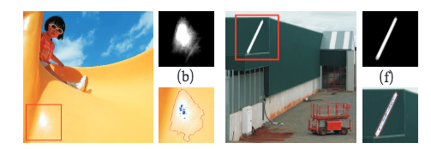
Weather Classification with Deep Convolutional Neural Networks
Prior Solution (Lu etal, CVPR, 2014).
621 feature vector formed by
Sky
Shadow
Reflection
Contrast
Haze
10

Slide 11
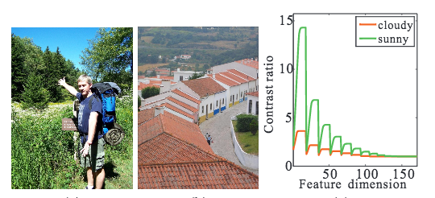
Weather Classification with Deep Convolutional Neural Networks
Prior Solution (Lu etal, CVPR, 2014).
621 feature vector formed by
Sky
Shadow
Reflection
Contrast
Haze
11

Slide 12
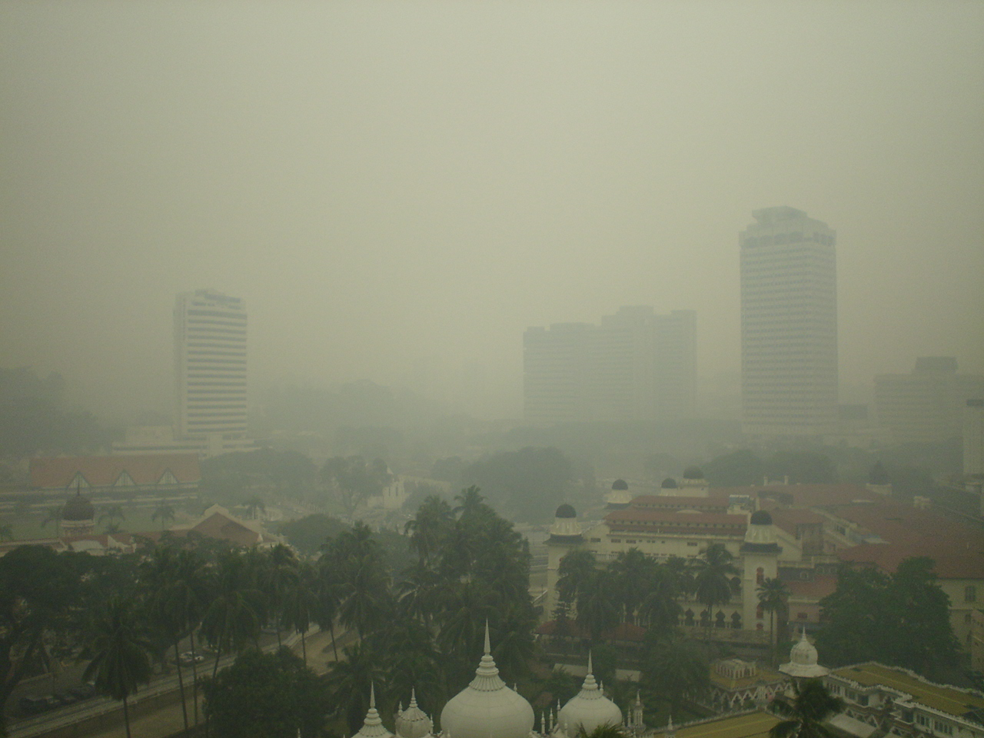
Weather Classification with Deep Convolutional Neural Networks
Prior Solution (Lu etal, CVPR, 2014).
621 feature vector formed by
Sky
Shadow
Reflection
Contrast
Haze
12

Slide 13
Weather Classification with Deep Convolutional Neural Networks
Prior Solution (Lu etal, CVPR, 2014).
621 feature vector formed by
Sky
Shadow
Reflection
Contrast
Haze
Based on these features collaborative learning algorithm was built on top to classify the weather in images.
13

Slide 14
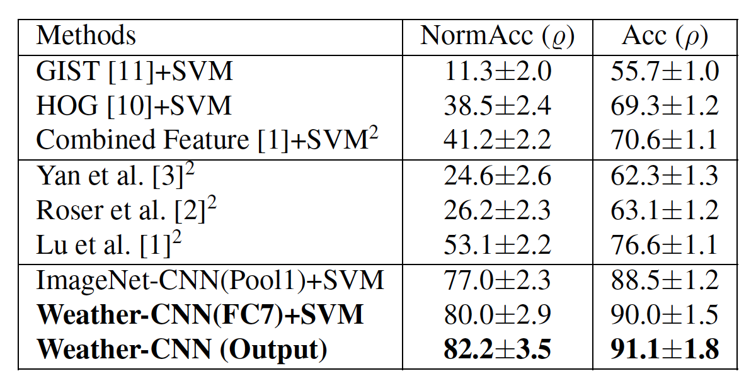
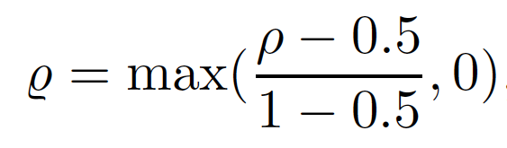
Weather Classification with Deep Convolutional Neural Networks
Existing methods for weather Classification, based on the latest dataset collected by Lu et al, CVPR, 2014
14

Slide 15
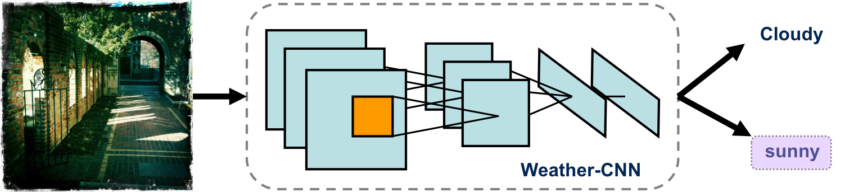
Weather Classification with Deep Convolutional Neural Networks
CNN Study (Based on AlexNet, NIPS, 2012)
15
Notes:
Go over the architecture? What a fully connected layer , convolutional layer, pooling g layer.
What is the loss function, learning rate, dataset, binary classification
How it was optimized

Slide 16
Weather Classification with Deep Convolutional Neural Networks
Detailed Weather CNN (Adapted to weather task starting from AlexNet, NIPS, 2012).
11
3
3
11
5
3
3
3
Input Image 227 x 227
5
3
256
384
384
256
96
3
4096
4096
16
Notes:
Go over the architecture? What a fully connected layer , convolutional layer, pooling g layer.
What is the loss function, learning rate, dataset, binary classification
How it was optimized

Slide 17
Weather Classification with Deep Convolutional Neural Networks
Existing methods for weather Classification
17

Slide 18
Weather Classification with Deep Convolutional Neural Networks
Comparison with the State of the Art
18

Slide 19
Weather Classification with Deep Convolutional Neural Networks
f
Three questions about CNNs for weather classification
How good is the representation at different layers of a pre-trained CNN?
How fine-tuning of a pre-trained CNN optimized for weather classification affect the representation at each layer?
How spatial coherence is important in CNN-based weather classification?
19

Slide 20
Weather Classification with Deep Convolutional Neural Networks
Q1) How good is the representation at different layers of a pre-trained CNN (i.e., ImageNet CNN)?
We computed neuron activations in these network as the representations of the network
pool1
pool2
conv3
conv4
pool5
11
3
3
11
5
3
3
3
Input Image 227 x 227
5
3
256
384
384
256
96
3
ImageNet CNN (Blue)
Output =1000 classes
1000
4096
4096
output
fc7
20
fc6

Slide 21
Weather Classification with Deep Convolutional Neural Networks
Q1) How good is the representation at different layers of a pre-trained CNN (i.e., ImageNet CNN)?
We computed neuron activations in these network as the representations of the network
pool1
pool2
conv3
conv4
pool5
11
3
3
11
5
3
3
3
Input Image 227 x 227
5
3
256
384
384
256
96
3
4096
4096
output
fc7
21
fc6

Slide 22
Weather Classification with Deep Convolutional Neural Networks
Q1) How good is the representation at different layers of a pre-trained CNN (i.e., ImageNet CNN)?
ImageNet CNN (Blue)
22

Slide 23
Weather Classification with Deep Convolutional Neural Networks
Q1) How Weather adapted CNN optimized affect the representation at each layer of the network/ improve on the ImageNet CNN?
pool1
pool2
conv3
conv4
pool5
11
3
3
11
5
3
3
3
Input Image 227 x 227
5
3
256
384
384
256
96
3
Weather CNN (Red)
Output = weather classes
4096
4096
output
fc7
23
fc6

Slide 24
Weather Classification with Deep Convolutional Neural Networks
Q2) How fine-tuning of a pre-trained CNN optimized for weather classification dataset affect the representation at each layer of the network?
82.2%
77.3%
Weather CNN (Red)
24

Slide 25
Weather Classification with Deep Convolutional Neural Networks
Weather CNN (adapted CNN) improvement over ImageNet CNN (pre-trained).
25

Slide 26
Weather Classification with Deep Convolutional Neural Networks
Q3) How spatial coherence is important in CNN-based weather classification?
1. Scramble image into
M x N rectangles
2. Shuffle them
3. Evaluated CNN on the
scrambled image
N columns
M rows
26
Notes:
Add spatial why needs to be done? It is not n. Since forcused on spatia coherence is a big dea. See how performance is changed when we change the task.

Slide 27
Weather Classification with Deep Convolutional Neural Networks
Q3) How spatial coherence is important in CNN-based classification?
ImageNet CNN
27

Slide 28
Weather Classification with Deep Convolutional Neural Networks
Comparison with the State of the Art
28

Slide 29
Conclusion
We propose to solve weather classification from images using CNN.
To help understand CNNs for weather classification, we performed
Layer by layer analysis for the pre-trained CNN.
Layer by layer analysis for the weather-adapted CNN.
A Study of the effect of spatial distortion on weather classification.
29
Notes:
MULTI-CLASS WEATHER CLASSIFICATION ON SINGLE IMAGES

Slide 30
Future Work
Scramble layer Analysis on weather optimized CNN.
Applying weather CNN on the new weather dataset with 4 weather classes. “Zhang et al, ICIP, 2015”.
30
Notes:
MULTI-CLASS WEATHER CLASSIFICATION ON SINGLE IMAGES

Slide 31


Weather Classification with Deep Convolutional Neural Networks
You can download the Weather CNN models and try them yourself
Project Website:
https://sites.google.com/site/mhelhoseiny/computer-vision-projects/weather-classification-cnn
31

